Slide 1
Soft Skills

Slide 2

Introduction
Soft skills are non-technical skills that relate to how you work
Include how you interact with colleagues, how you solve problems, and how you manage your work.
They are often referred to as transferable skills or professional skills.

Slide 3
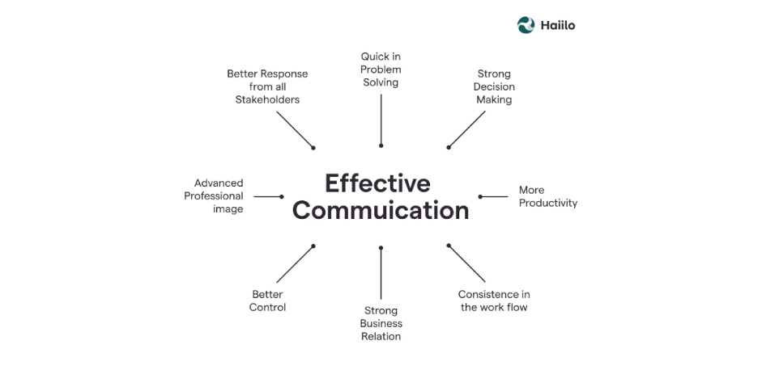
Communication Skills
Verbal Communication:
Clearly conveying information and ideas through speech.
Written Communication:
Effectively writing text to convey a message.
Listening:
Paying attention to others when they speak and engaging in active listening.

Slide 4
"a software engineer is a highly skilled professional in a technical area. Without the proper training, it’s near impossible for a non-technical colleague to understand your work without your help."

Slide 5

Interpersonal Skills
Teamwork:
Working well with others to achieve a common goal.
Empathy:
Understanding and sharing the feelings of others.
Networking:
Building and maintaining professional relationships.

Slide 6
Personal Attributes
Adaptability:
Adjusting to new challenges and environments.
Work Ethic:
Showing dedication and commitment to completing tasks.
Resilience:
Bouncing back from setbacks (recover).

Slide 7
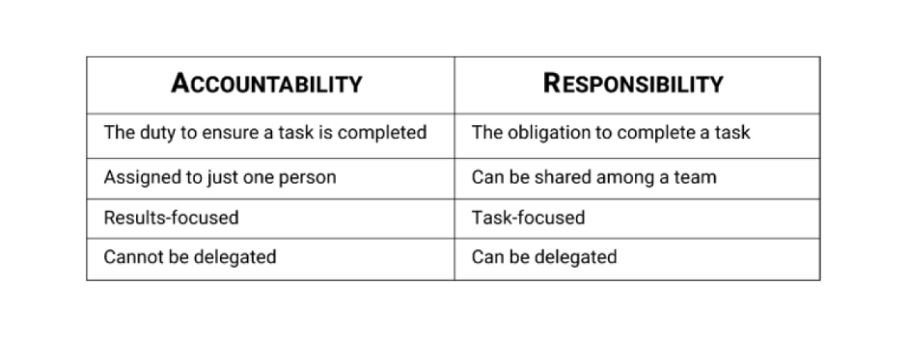
Responsibility and Accountability
" showing a sense of responsibility, accountability, and a desire to be a part of the solution can save your managers and colleagues time and effort, as well as demonstrate your reliability, even despite having made a mistake"

Slide 8
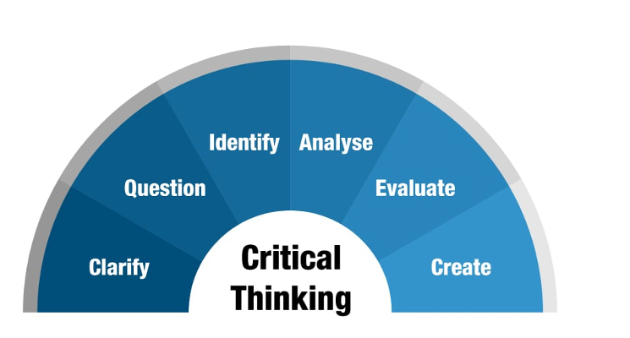
Problem-Solving Skills
Critical Thinking:
Analyzing situations and making decisions based on logic and reasoning.
Creativity:
Generating innovative solutions to problems.
Conflict Resolution:
Handling disagreements and disputes constructively.

Slide 9

Leadership and Management Skills
Delegation:
Assigning tasks to others appropriately.
Motivation:
Inspiring and encouraging others to achieve their best.
Feedback:
Providing constructive criticism and guidance.

Slide 10
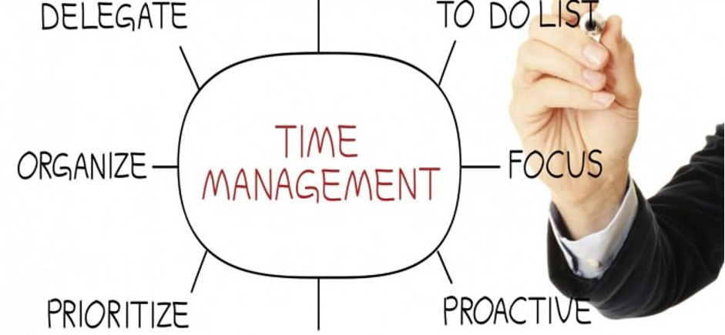
Organizational Skills
Time Management:
Prioritizing tasks and managing time effectively.
Project Management:
Organizing and overseeing projects to completion.
Multitasking:
Handling multiple responsibilities simultaneously.

